Slide 1
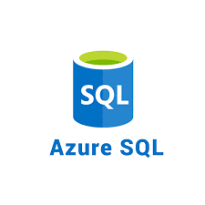

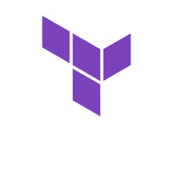


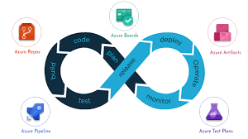
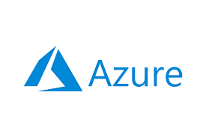
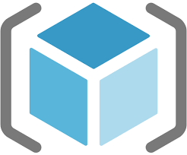
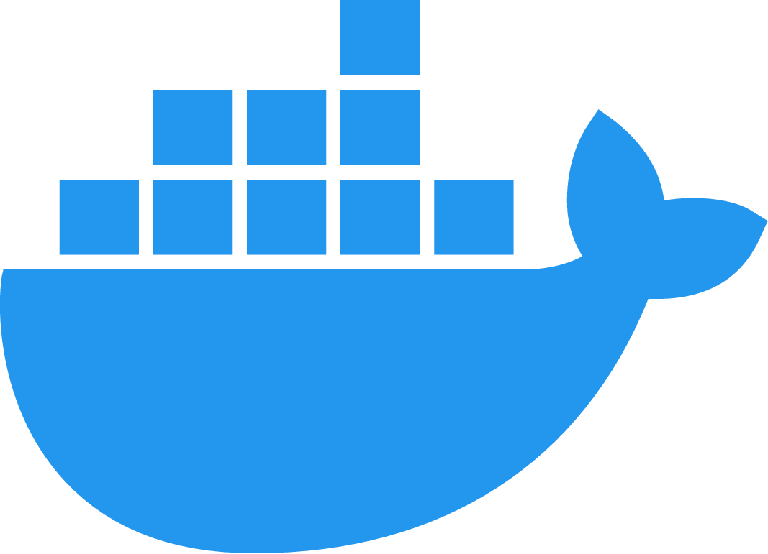

Network Basics

Slide 2
Computer Networks
DEFINTION:
A computer network is defined as the interconnection of two or more computers. It is done to enable the computers to communicate and share available resources.
APPLICATIONS:
Sharing of resources such as printers
Sharing of expensive software's and database
Communication from one computer to another computer
Exchange of data and information among users via network
Sharing of information over geographically wide areas.

Slide 3
Computer Networks
Classification of Computer Networks:
Local Area Network(LAN)
Wide Area Network(WAN)
Metropolitan Area Network(MAN)
Personal Area Network(PAN)
Campus Area Network(CAN)

Slide 4
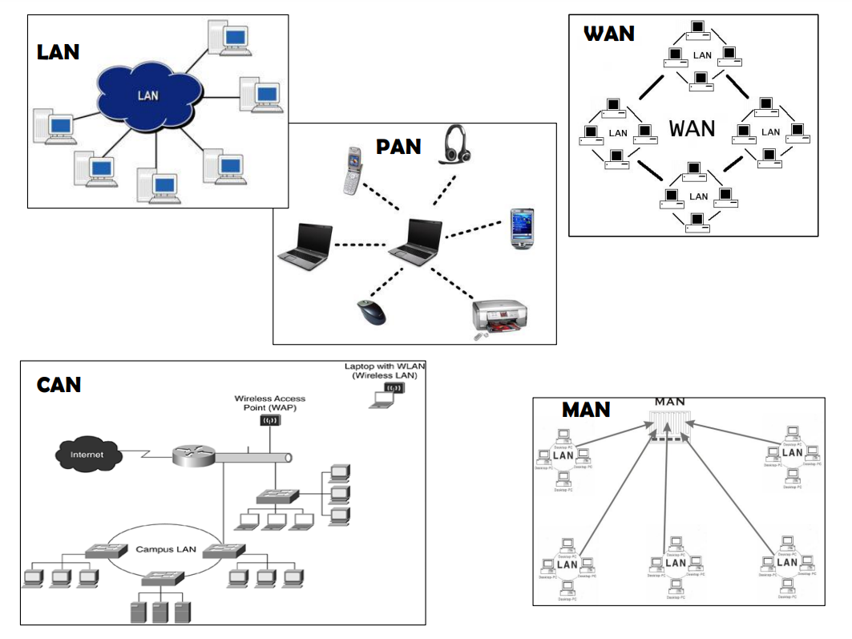
Computer Networks

Slide 5
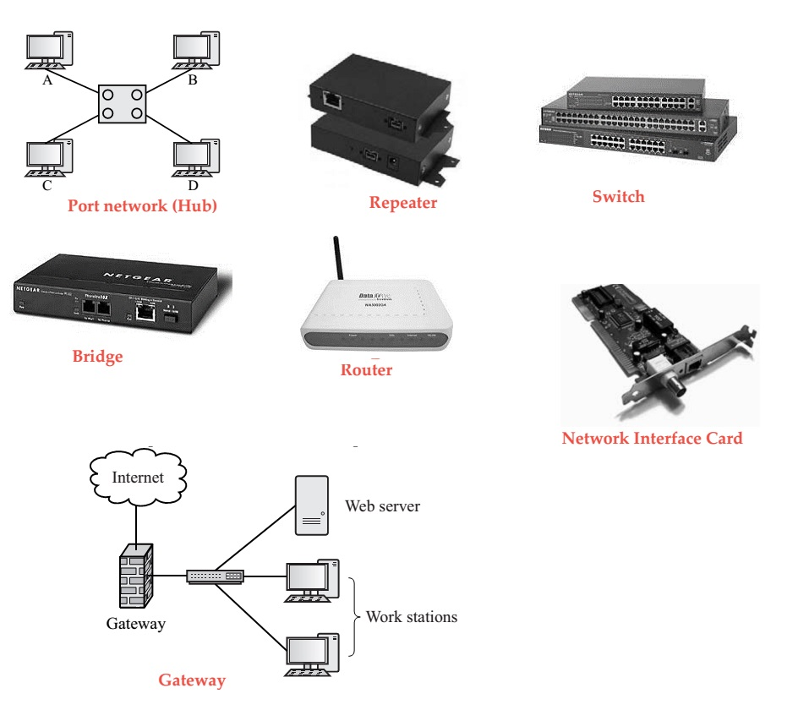
Computer Networks
Network Devices

Slide 6
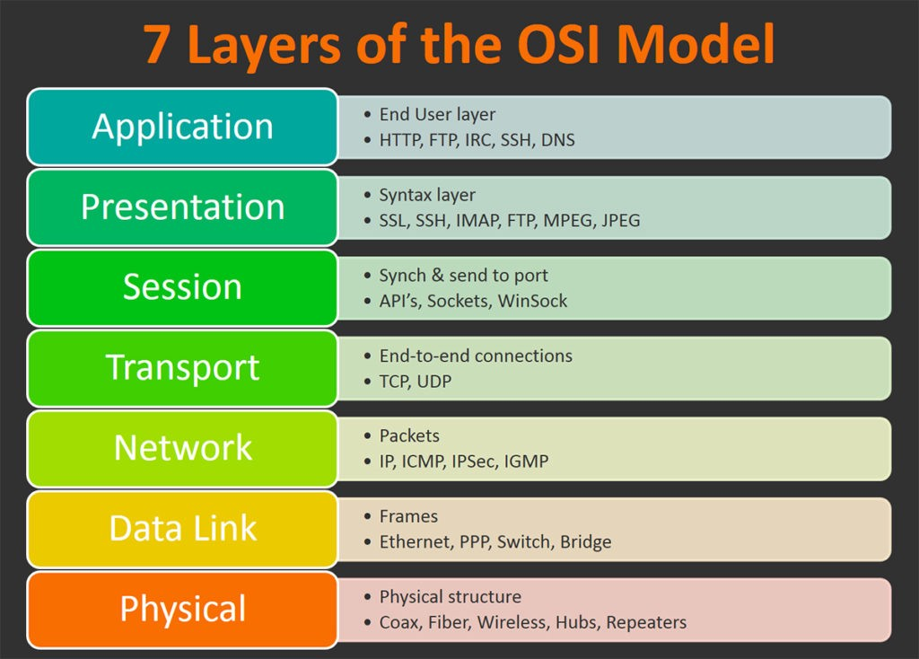
Computer Networks
Open Systems Interconnection Model (OSI)

Slide 7
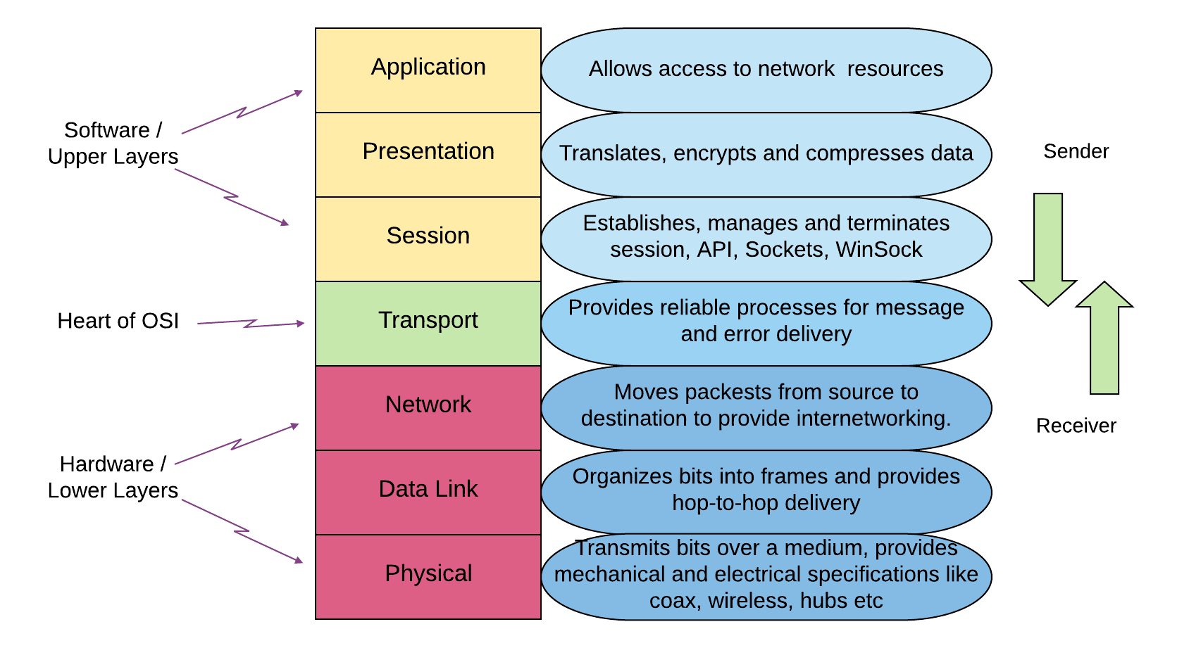
Computer Networks
OSI Layer

Slide 8
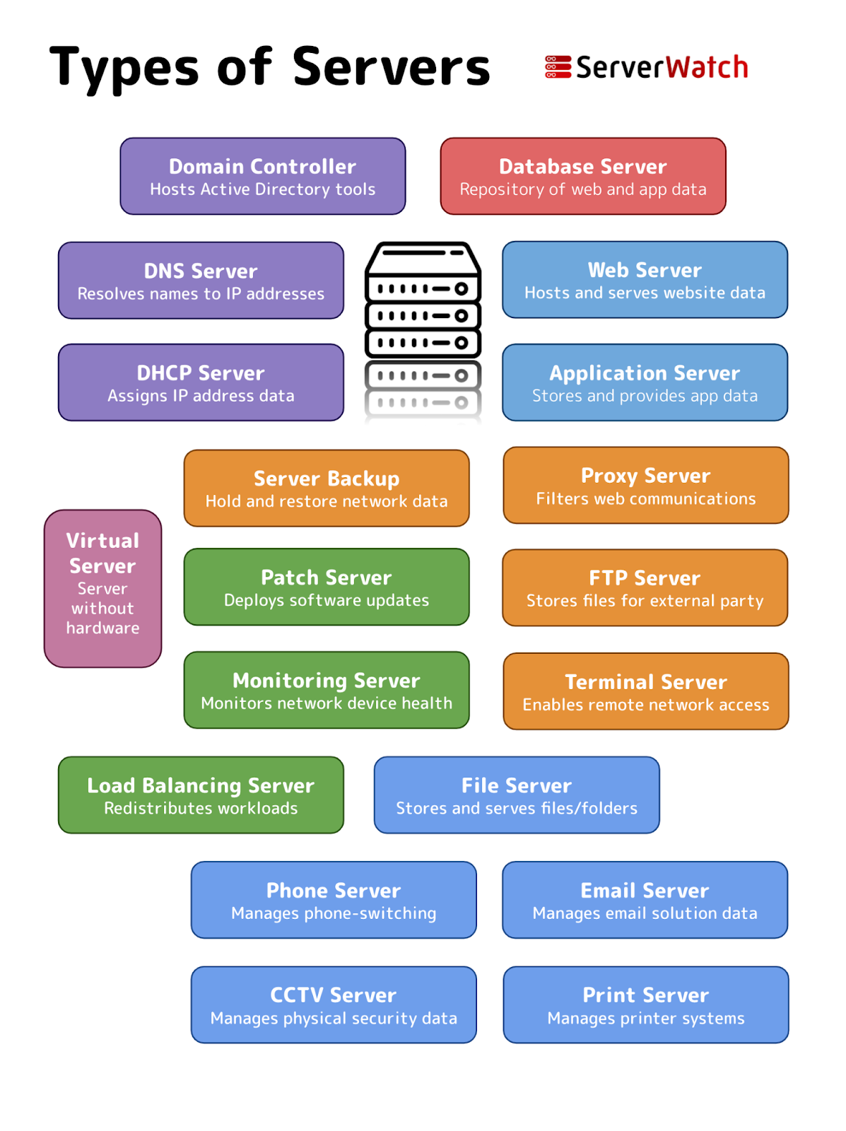
Computer Networks
Types Of Servers

Slide 9
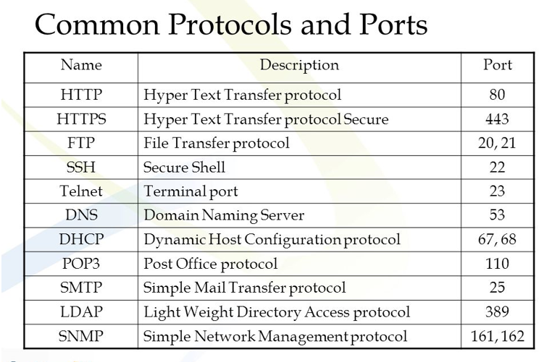
Computer Networks
Protocols and Ports

Slide 10
Computer Networks
Protocol:
A network protocol is an established set of rules that determine
how data is transmitted between different devices in the same network
IP Address:
IP address stands for internet protocol address.
it is an identifying number that is associated with a specific computer or computer network
DNS (Domain Name System):
The Domain Name System (DNS) Server is a server that is specifically used for matching website
hostnames (like example.com)to their corresponding Internet Protocol or IP addresses.
DHCP(Dynamic Host Configuration Protocol):
Dynamic Host Configuration Protocol (DHCP) is a client/server protocol that automatically
provides an Internet Protocol (IP) host with its IP address and other related configuration information
such as the subnet mask and default gateway
Gateway
A gateway is a network node used in telecommunications that connects two networks with different transmission protocols together

Slide 11
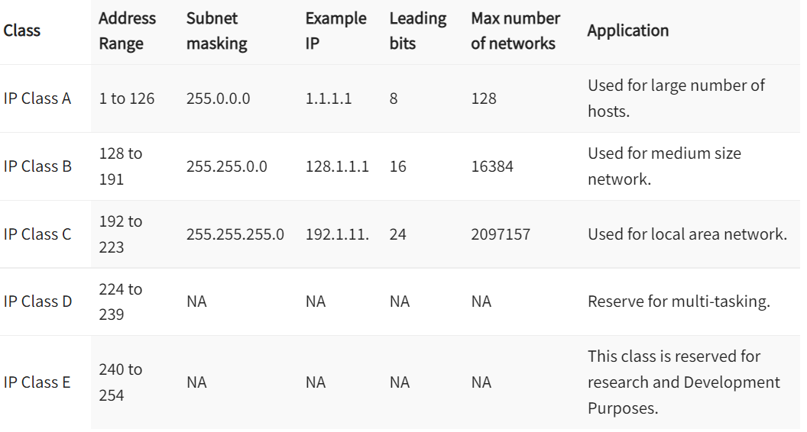
Computer Networks
IP Address Classifications:

Slide 12
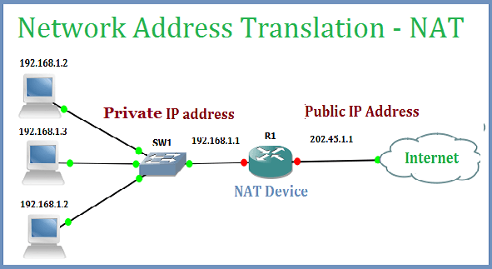
Computer Networks
NAT:

Slide 13

Azure Virtual Networks
Azure Virtual Networks (VNets) are the fundamental building block of your private network in Azure.
VNets enable you to build complex virtual networks that are similar to an on-premises network,
with additional benefits of Azure infrastructure such as scale, availability, and isolation.
A VNet is a representation of your own network in the cloud. It is a logical isolation of the Azure cloud dedicated to your subscription
Capabilities of Azure Virtual Networks
Azure VNets enable resources in Azure to securely communicate with each other, the internet, and on-premises networks.
Communication with the internet. All resources in a VNet can communicate outbound to the internet, by default.
You can communicate inbound to a resource by assigning a public IP address or a public Load Balancer.
You can also use public IP or public Load Balancer to manage your outbound connections.
Communication between Azure resources. There are three key mechanisms through which Azure resource can communicate: VNets,
VNet service endpoints and VNet peering. Virtual Networks can connect not only VMs, but other Azure Resources,
such as the App Service Environment, Azure Kubernetes Service, and Azure virtual machine scale sets.
You can use service endpoints to connect to other Azure resource types, such as Azure SQL databases and storage accounts.
When you create a VNet, your services and VMs within your VNet can communicate directly and securely with each other in the cloud.
Communication between on-premises resources. Securely extend your data center. You can connect your on-premises computers and
networks to a virtual network using any of the following options: Point-to-site virtual private network (VPN), Site-to-site VPN, Azure ExpressRoute.
Filtering network traffic. You can filter network traffic between subnets using any combination of network security groups and network virtual appliances
like firewalls, gateways, proxies, and Network Address Translation (NAT) services.
Routing network traffic. Azure routes traffic between subnets, connected virtual networks, on-premises networks, and the Internet, by default.
You can implement route tables or border gateway protocol (BGP) routes to override the default routes Azure creates.

Slide 14
Azure Virtual Networks
Recommended IP Address Space:
Class A: 10.0.0.0 - 10.255.255.255 (10/8 prefix)
Class B: 172.16.0.0 - 172.31.255.255 (172.16/12 prefix)
Class C: 192.168.0.0 - 192.168.255.255 (192.168/16 prefix)
Should not used IP Addresses:
224.0.0.0/4 (Multicast)
255.255.255.255/32 (Broadcast)
127.0.0.0/8 (Loopback)
169.254.0.0/16 (Link-local)
168.63.129.16/32 (Internal DNS)
Azure Reserved 5 IP addresses
x.x.x.0: Network address
x.x.x.1: Reserved by Azure for the default gateway
x.x.x.2, x.x.x.3: Reserved by Azure to map the Azure DNS IPs to the VNet space
x.x.x.255: Network broadcast address

Slide 15
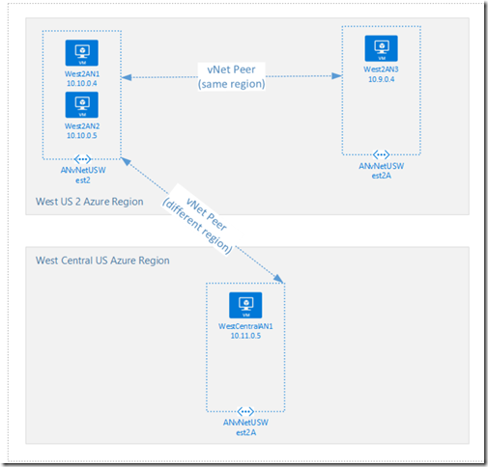

VNET Peering
Azure VNET peering allows connecting virtual networks seamlessly via Azure backbone infrastructure.
This is similar to inter-VLAN routing in on-premises networks.
The traffic will not pass via the public internet.
It provides low latency, high bandwidth connectivity between virtual networks.
VNET peering can use to connect virtual networks in the same Azure region or different Azure regions.

Slide 16
NSG vs ASG
Network Security Group
A network security group is used to enforce and control network traffic.
Controls the inbound and outbound traffic at the subnet level.
Rules are applied to all resources in the associated subnet.
Has separate rules for inbound and outbound traffic.
NSG has a limit of 1000 rules.
Supports ALLOW and DENY rules.
Not allowed to specify multiple IP addresses and IP address ranges in the NSG created by the classic deployment model.
Application Security Group
An application security group is an object reference within an NSG.
Controls the inbound and outbound traffic at the network interface level.
Rules are applied to all ASGs in the same virtual network.
Has separate rules for inbound and outbound traffic.
ASGs that can be specified within all security rules of an NSG have a limit of 100 rules.
Supports ALLOW and DENY rules.
Not allowed to specify multiple ASGs in the source or destination.

Slide 17
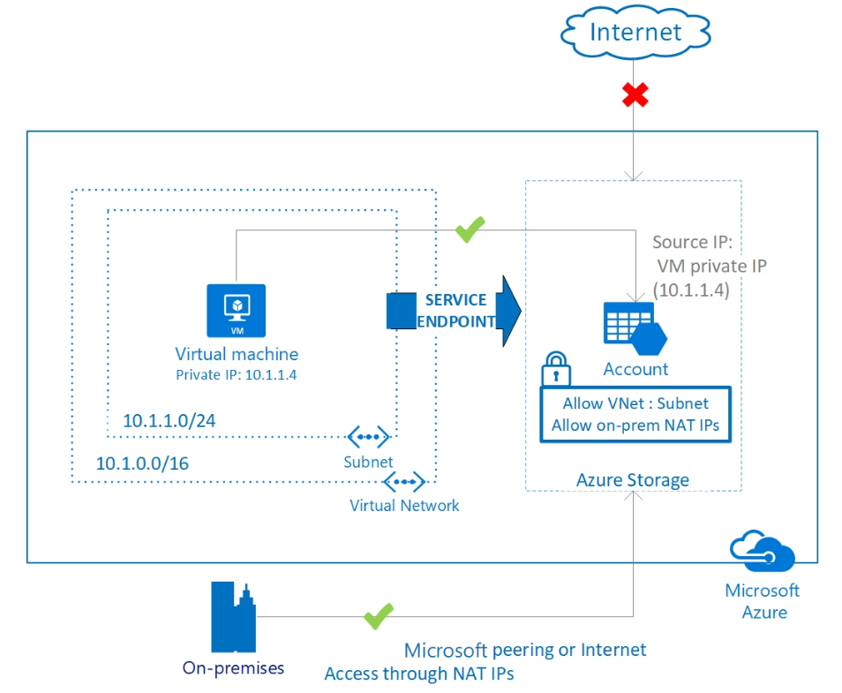
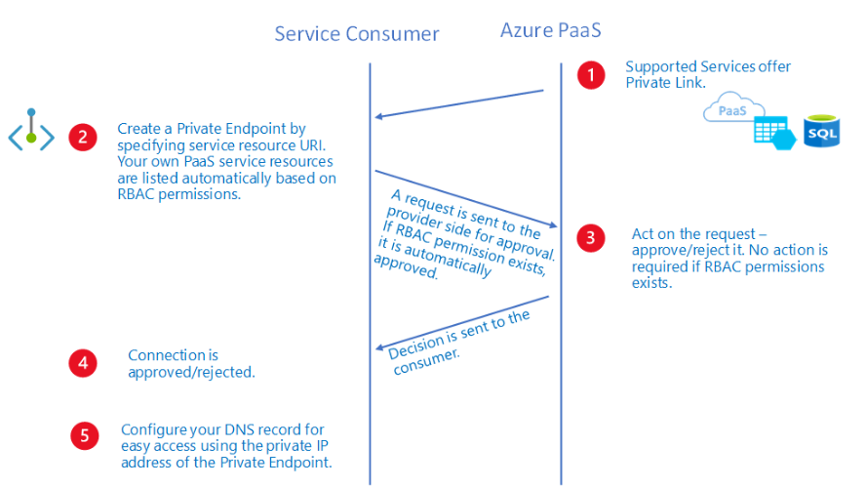
Service end point and private end point
Service Endpoint
Virtual Network (VNet) service endpoint provides secure and direct connectivity to Azure services over an optimized route over the Azure backbone network. Endpoints allow you to secure your critical Azure service resources to only your virtual networks. Service Endpoints enables private IP addresses in the VNet to reach the endpoint of an Azure service without needing a public IP address on the VNet.
Private Endpoint
Private endpoints provide a privately accessible IP address for the Azure service, but do not necessarily restrict public network access to it. Azure App Service and Azure Functions become inaccessible publicly when they are associated with a private endpoint. All other Azure services require additional access controls, however. These controls provide an extra network security layer to your resources, providing protection that helps prevent access to the Azure service associated with the private-link resource.

Slide 18
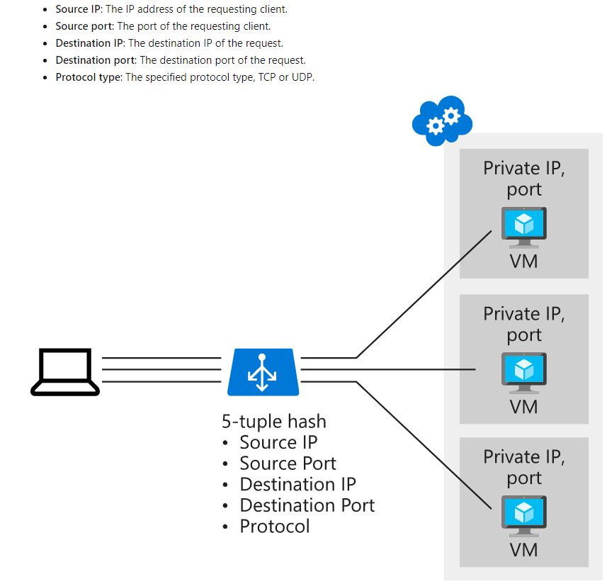
Azure Load balancer
Azure Load Balancer is a service you can use to distribute traffic across multiple virtual machines.
Use Load Balancer to scale applications and create high availability for your virtual machines and services
Basic load balancers allow:
Port forwarding
Automatic reconfiguration
Health probes
Outbound connections through source network address translation (SNAT)
Diagnostics through Azure Log Analytics for public-facing load balancers
Basic load balancers can be used only with a single availability set or scale set.
Standard load balancers support all of the basic load balancer features. They also allow:
HTTPS health probes
Availability zones
Diagnostics through Azure Monitor, for multidimensional metrics
High availability (HA) ports
Outbound rules
A guaranteed SLA (99.99% for two or more virtual machines)

Slide 19
Azure Traffic manager
Azure Traffic Manager is a DNS-based traffic load balancer. This service allows you to distribute traffic to your public facing applications across the global Azure regions.
Traffic Manager also provides your public endpoints with high availability and quick responsiveness.
The most important point to understand is that Traffic Manager works at the DNS level which is at the Application layer (Layer-7).
The following traffic routing methods are available in Traffic Manager:
Priority: Select Priority routing when you want to have a primary service endpoint for all traffic.
You can provide multiple backup endpoints in case the primary or one of the backup endpoints is unavailable.
Weighted: Select Weighted routing when you want to distribute traffic across a set of endpoints based on their weight.
Set the weight the same to distribute evenly across all endpoints.
Performance: Select Performance routing when you have endpoints in different geographic locations and
you want end users to use the "closest" endpoint for the lowest network latency.
Geographic: Select Geographic routing to direct users to specific endpoints (Azure, External, or Nested) based on where their DNS queries originate f rom geographically. With this routing method, it enables you to be in compliance with scenarios such as data sovereignty mandates,
localization of content & user experience and measuring traffic from different regions.
Multivalue: Select MultiValue for Traffic Manager profiles that can only have IPv4/IPv6 addresses as endpoints.
When a query is received for this profile, all healthy endpoints are returned.
Subnet: Select Subnet traffic-routing method to map sets of end-user IP address ranges to a specific endpoint. When a request is received,
the endpoint returned will be the one mapped for that request’s source IP address.

Slide 20
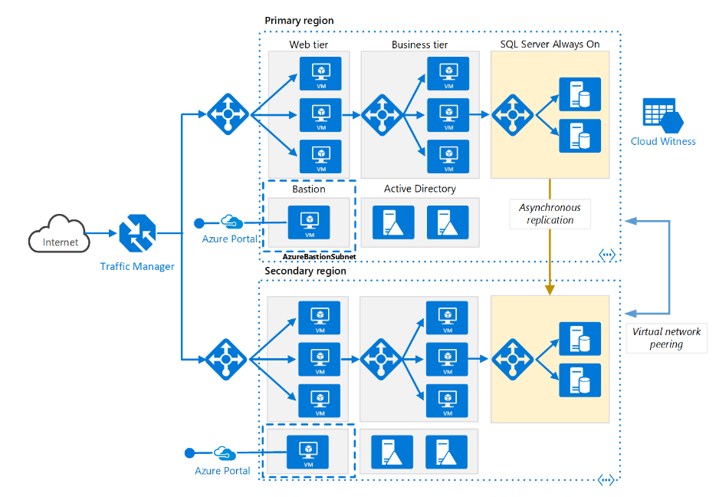
Azure Traffic manager
Scenario:
In this example scenario, we use a simple website that serves two types of content: images and dynamically rendered webpages. The website must be geographically redundant, and it should serve its users from the closest (lowest latency) location to them. The application developer has decided that any URLs that match the pattern /images/* are served from a dedicated pool of VMs that are different from the rest of the web farm.
Additionally, the default VM pool serving the dynamic content needs to talk to a back-end database that is hosted on a high-availability cluster. The entire deployment is set up through Azure Resource Manager.
Using Traffic Manager, Application Gateway, and Load Balancer allows this website to achieve these design goals:
Multi-geo redundancy: If one region goes down, Traffic Manager routes traffic seamlessly to the closest region without any intervention from the application owner.
Reduced latency: Because Traffic Manager automatically directs the customer to the closest region, the customer experiences lower latency when requesting the webpage contents.
Independent scalability: Because the web application workload is separated by type of content, the application owner can scale the request workloads independent of each other. Application Gateway ensures that the traffic is routed to the right pools based on the specified rules and the health of the application.
Internal load balancing: Because Load Balancer is in front of the high-availability cluster, only the active and healthy endpoint for a database is exposed to the application. Additionally, a database administrator can optimize the workload by distributing active and passive replicas across the cluster independent of the front-end application. Load Balancer delivers connections to the high-availability cluster and ensures that only healthy databases receive connection requests.

Slide 21
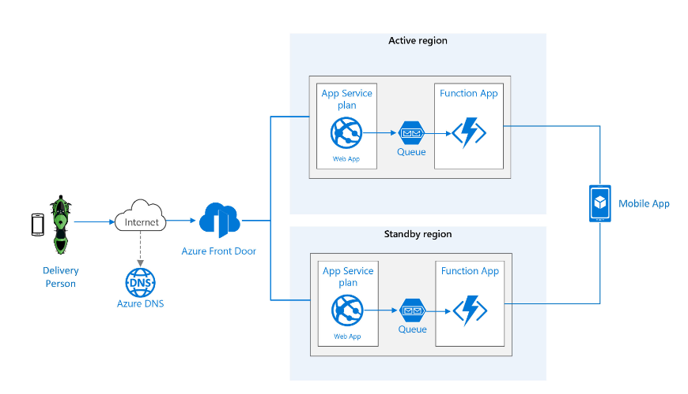
Azure Front Door
Azure Front Door is Microsoft’s modern cloud Content Delivery Network (CDN) that provides fast, reliable, and secure access between your users and your applications’ static and dynamic web content across the globe. Azure Front Door delivers your content using the Microsoft’s global edge network with hundreds of global and local POPs distributed around the world close to both your enterprise and consumer end users.

Slide 22
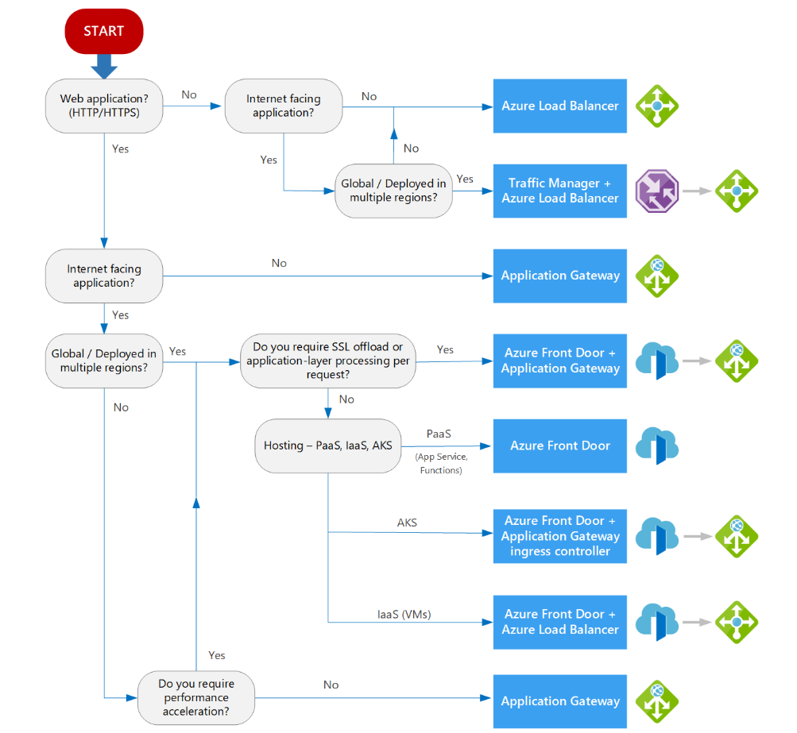
Azure load Balancer service decision tree
Definitions:
Internet facing. Applications that are publicly accessible from the internet. As a best practice, application owners apply restrictive access policies or protect the application by setting up offerings like web application firewall and DDoS protection.
Global. End users or clients are located beyond a small geographical area. For example, users across multiple continents, across countries/regions within a continent, or even across multiple metropolitan areas within a larger country/region.
PaaS. Platform as a service (PaaS) services provide a managed hosting environment, where you can deploy your application without needing to manage VMs or networking resources. In this case, PaaS refers to services that provide integrated load balancing within a region. See Choosing a compute service – Scalability.
AKS. Azure Kubernetes Service enables you to deploy and manage containerized applications. AKS provides serverless Kubernetes, an integrated continuous integration and continuous delivery (CI/CD) experience, and enterprise-grade security and governance. For more information about our AKS architectural resources, see Azure Kubernetes Service (AKS) architecture design.
IaaS. Infrastructure as a service (IaaS) is a computing option where you provision the VMs that you need, along with associated network and storage components. IaaS applications require internal load balancing within a virtual network, using Azure Load Balancer.
Application-layer processing refers to special routing within a virtual network. For example, path-based routing within the virtual network across VMs or virtual machine scale sets. For more information, see When should we deploy an Application Gateway behind Front Door?.

Slide 23
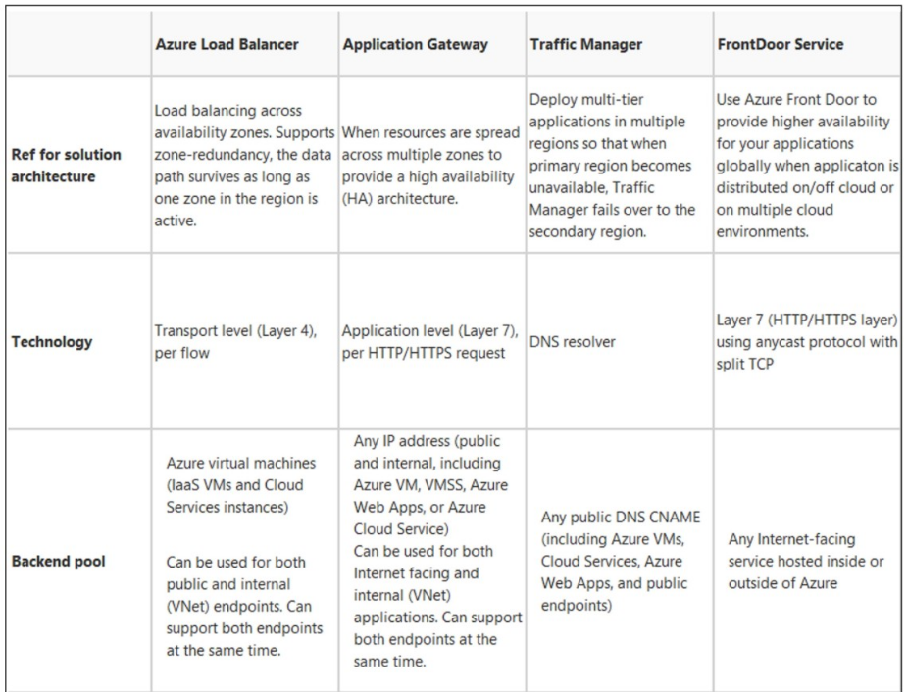

Slide 24
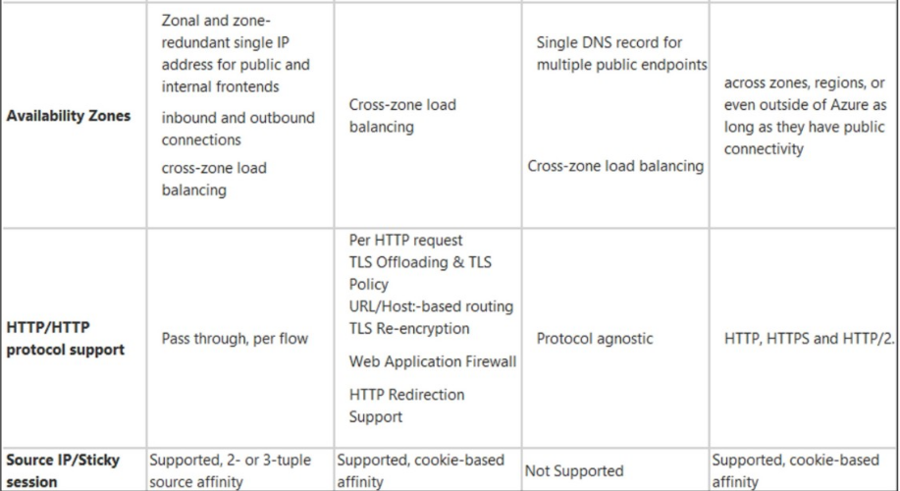

Slide 25
Any Questions?

Slide 26
Thank you…!!!

